Slide 1
Data Mining Project
AirBnb Price Prediction
Submitted by :Niral Desai
Vikrant Shelke

Slide 2
Content
Problem Statement
Observations
Dataset
Data Cleaning and Preprocessing
Visualization
Regression Models
Solutions and Future Work

Slide 3

Background
San Francisco based company created in 2008.
Offers an online marketplace for booking short term lodging and experiences.
Who can access?
Connects local host with travelers
Host can rent out their entire home, cozy cottages to luxurious penthouses,.
Travelers can look out various accommodation based on their personal preference.

Slide 4
Problem and solution
What is the problem?
No Simple way to get information.
Offered through their website, can be very pricey.
Not regularly updated and with day-to-day happenings.
Significant increase in price range with respect to number of bedrooms, neighborhood.
Solutions?
Finding comparable listing and averaging their prices is a common strategy but not always reliable.
Predicting the rates of Airbnb in New York, considering several independent variables like neighborhood, number of bedrooms etc.
This is a supervised learning regression problem.

Slide 5
Dataset
Some of the important aspects of the dataset we will be looking forward to work with are:
Last_scraped: Date on which the place is last rented out on.
Accomodates: How many people does it accommodates.
Beds/Bath: Number of beds and baths that place has.
Price: Price for the rented place.
Max_Nights: Maximum number of nights it can be rented out.
Min_Nights: Minimum number of nights it can be rented out.
Review_Score_Accuracy: Accurate review score.
Property Type: The Type of rented place is.

Slide 6
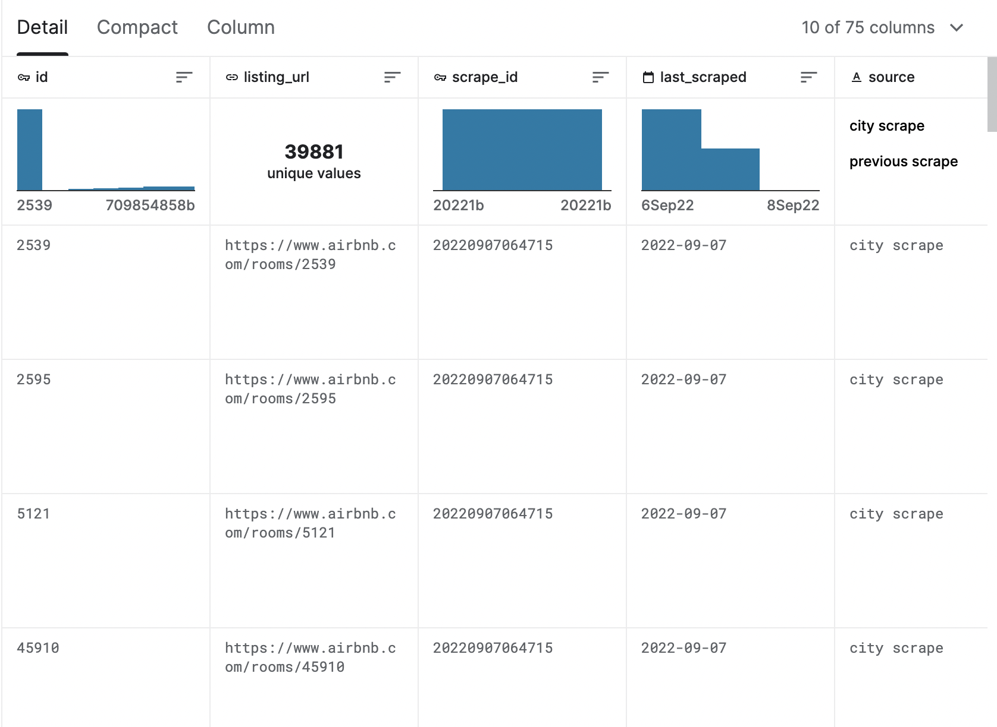
Dataset
Airbnb does not release its data to public hence it was hard getting the exact data, there are various sites like Inside Airbnb which provide us with data but its not exactly cheap.
Hence, we got ours from Kaggle and that is the closest we could get from Airbnb.

Slide 7
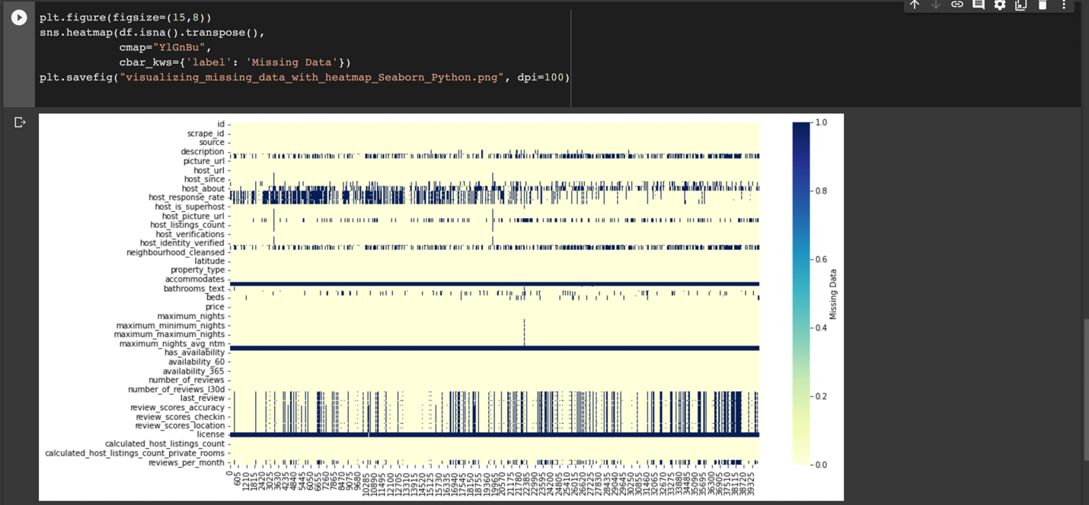
Data Collection and processing

Slide 8
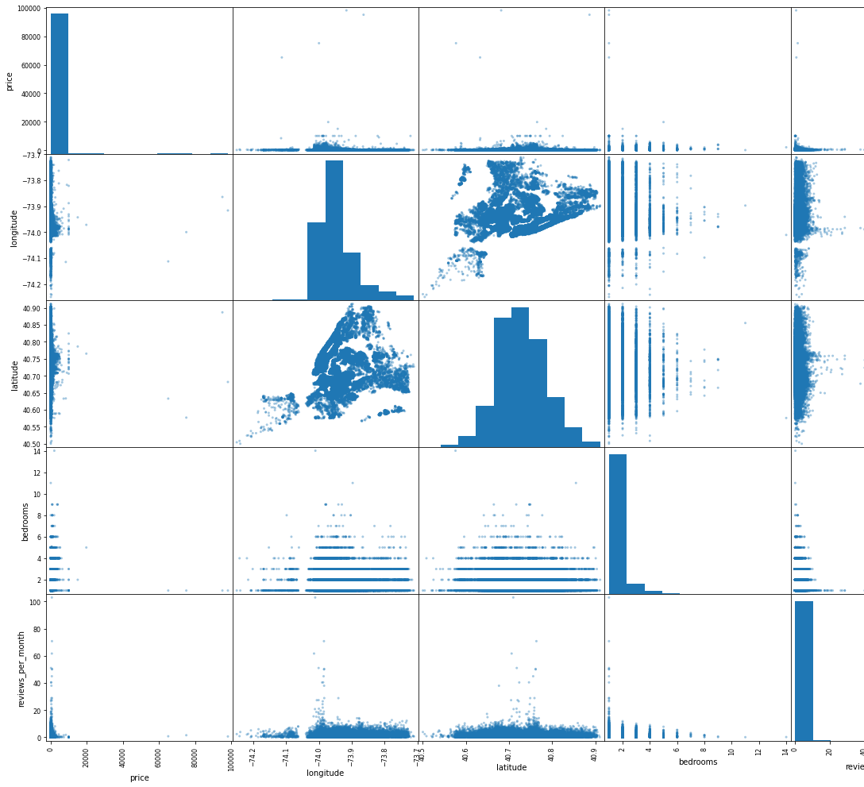
Data Collection and processing
Observation:
Outliers.
Target variable is highly skewed.
High Correlation

Slide 9
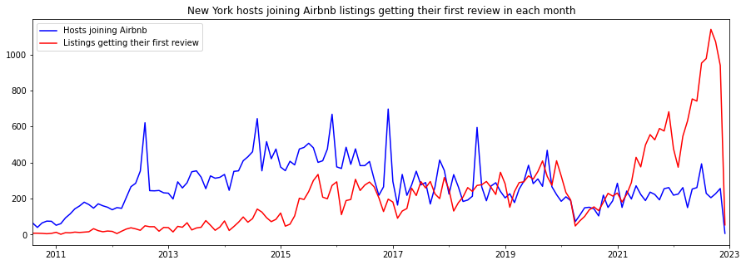
Exploratory Analysis

Slide 10
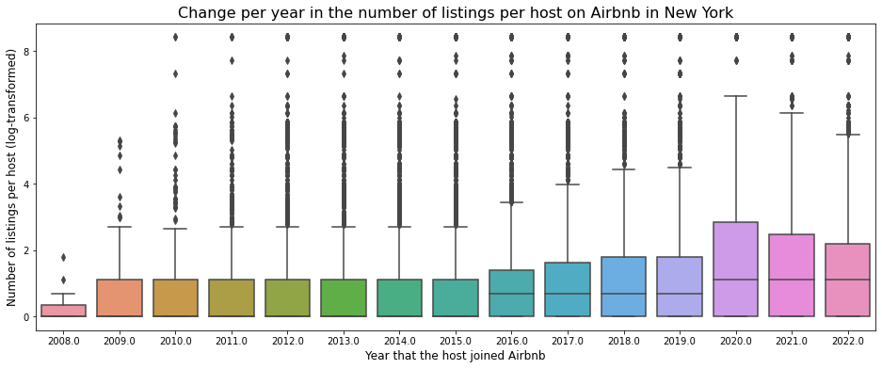
Exploratory Analysis

Slide 11
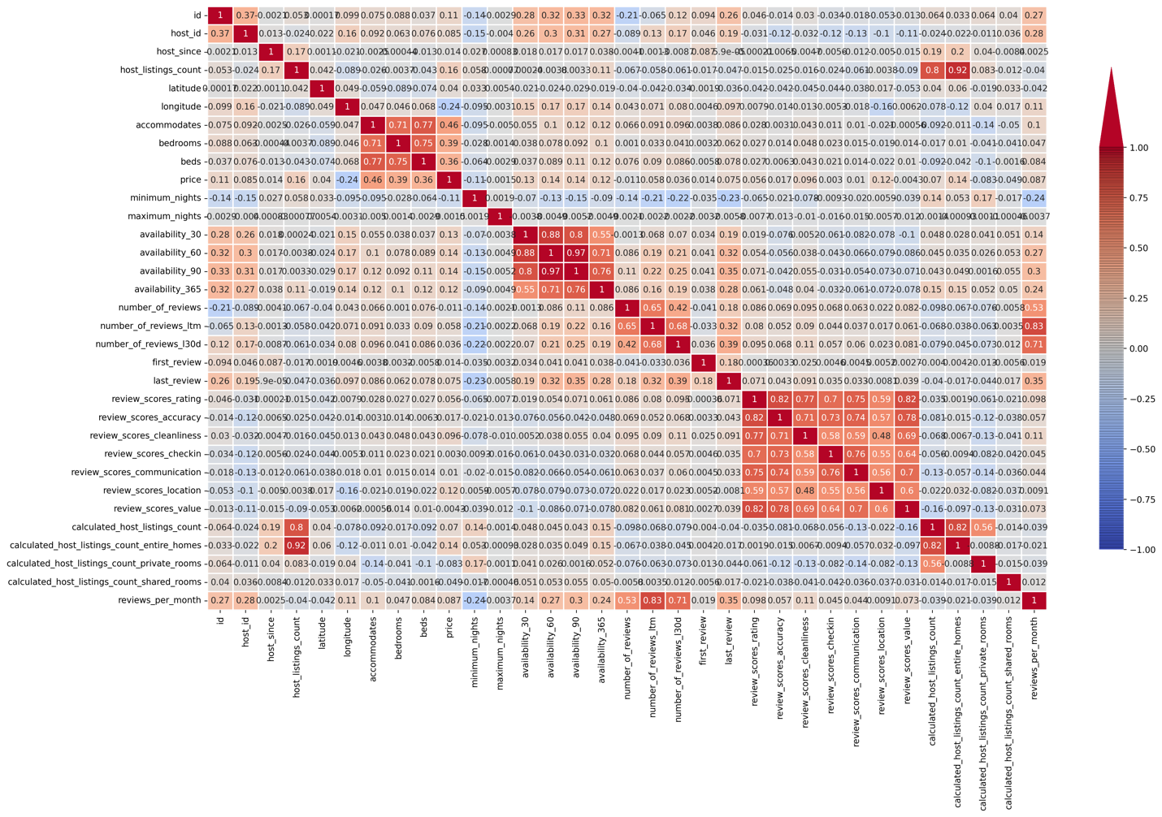
Data Preprocessing
Observation:
High Correlation

Slide 12
Data Preprocessing
Steps
Dropped unnecessary columns which did not add any value.
Dropped identical columns which gave the same information.
For example
host_total_listings_count and host_listings_count is almost unique.
maximum_nights_avg_ntm,minimum_nights_avg_ntm,maximum_maximum_nights,minimum_maximum_nights,maximum_minimum_nights,minimum_minimum_nights,minimum_nights,maximum_nights. These did not add any values.
There were few more like, host_url,host_thumbnail, picture_url,picture_url and more useless columns which we dropped.
Changed few column datatypes for example datetype and remove every special characters.
Handled missing value by dropping those with fewer missing value and for the rest used imputing.

Slide 13
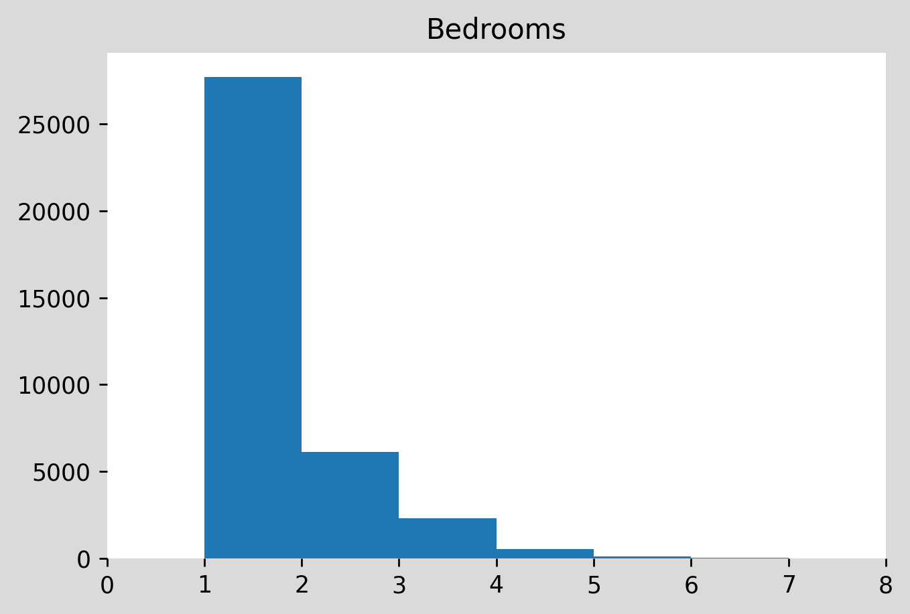
Data Preprocessing
An overview of rates per room

Slide 14
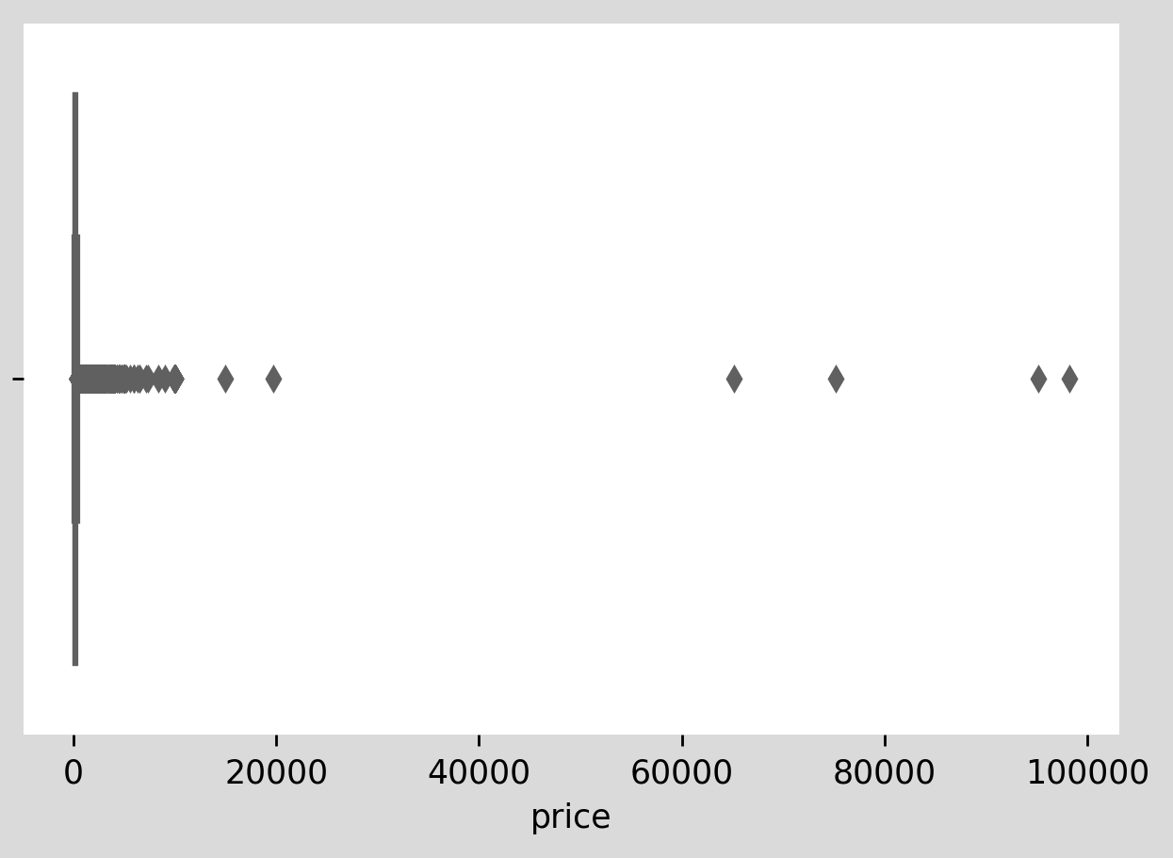
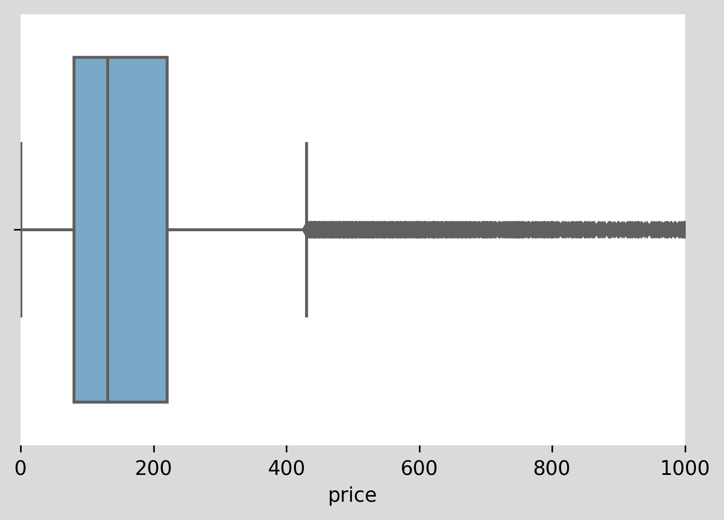
Data Preprocessing
Let's look at Price column
Its hard to believe that someone would spend more tan 20000 on an Airbnb.
So, we only considered property
under 1000

Slide 15
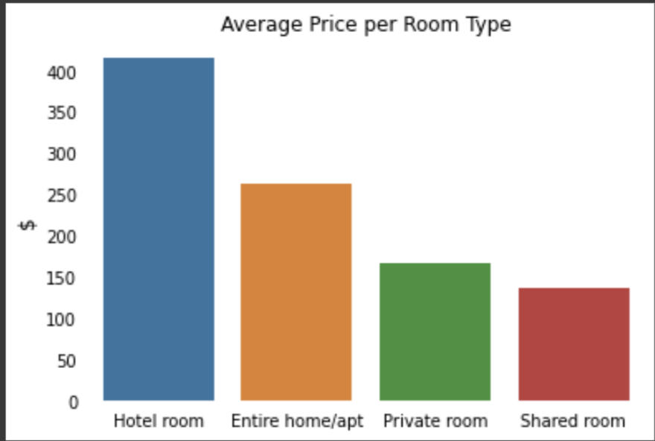
Data Preprocessing
Average price per room type

Slide 16
Model Exploration
Base model
Linear
Decision Tree
KNN
Random Forest
SVM
Gradient Boosting
Neural Net

Slide 17
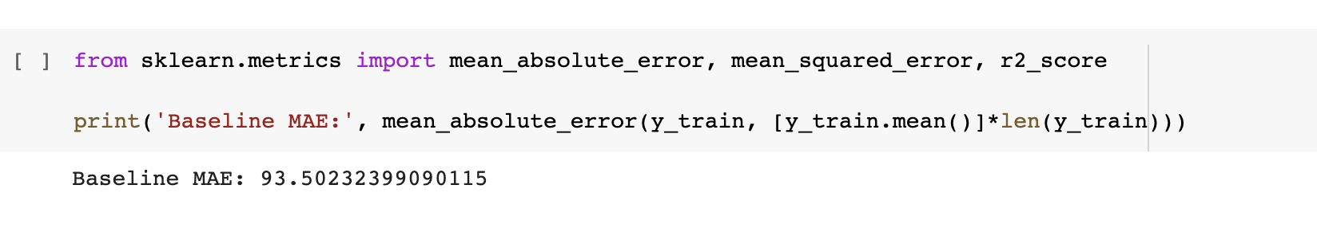
Base mODel

Slide 18
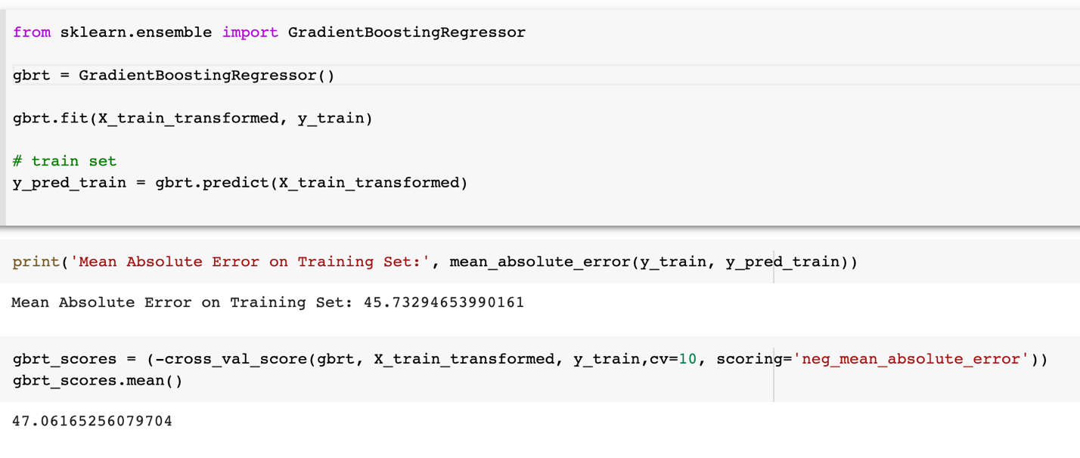
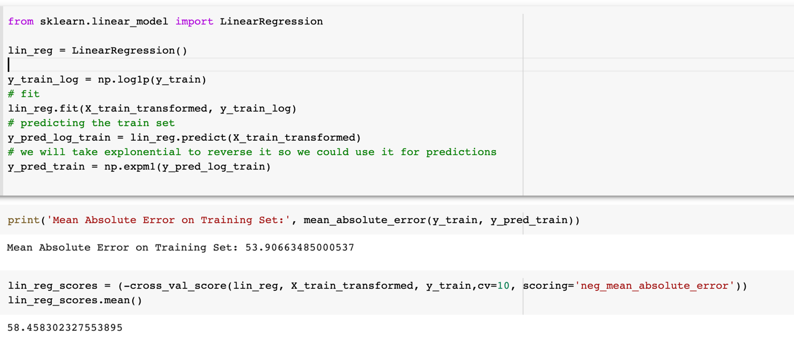
Linear Regression and SVM

Slide 19
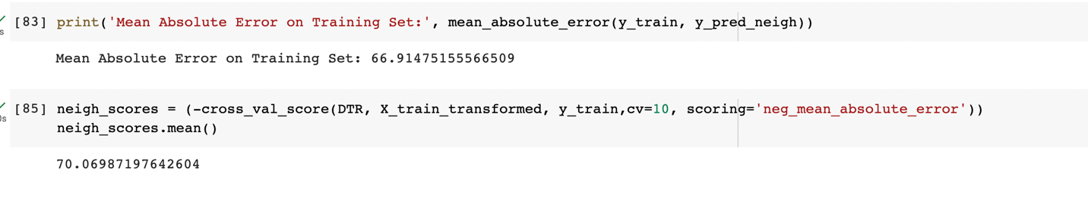
KNN

Slide 20
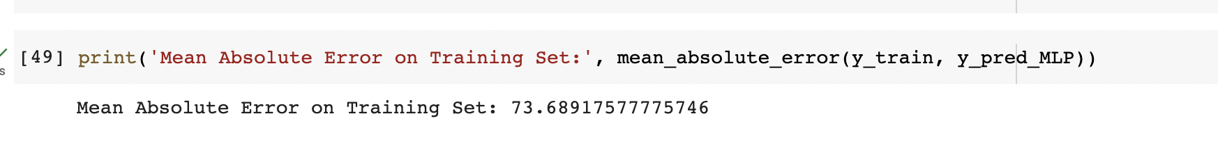
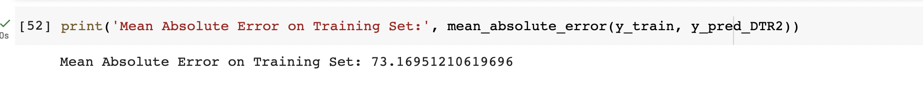
Neural Net and Decision tree
Neural Net
Decision Tree

Slide 21
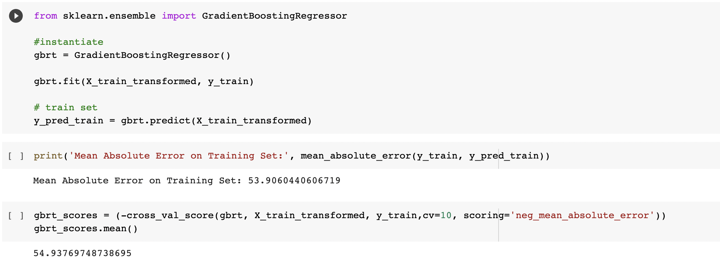
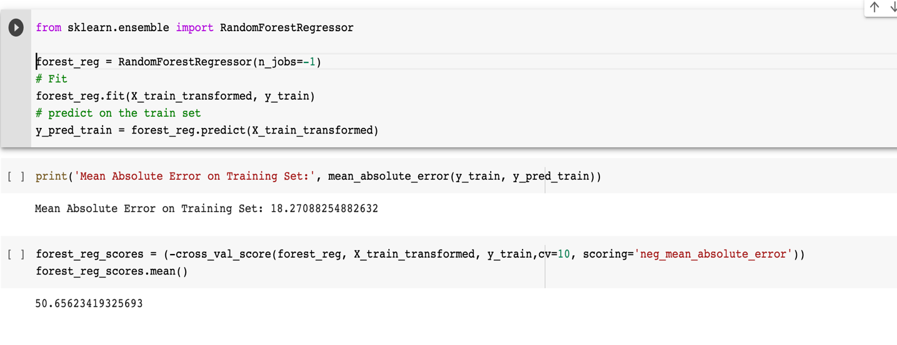
Random Forest and Gradient Boosting

Slide 22
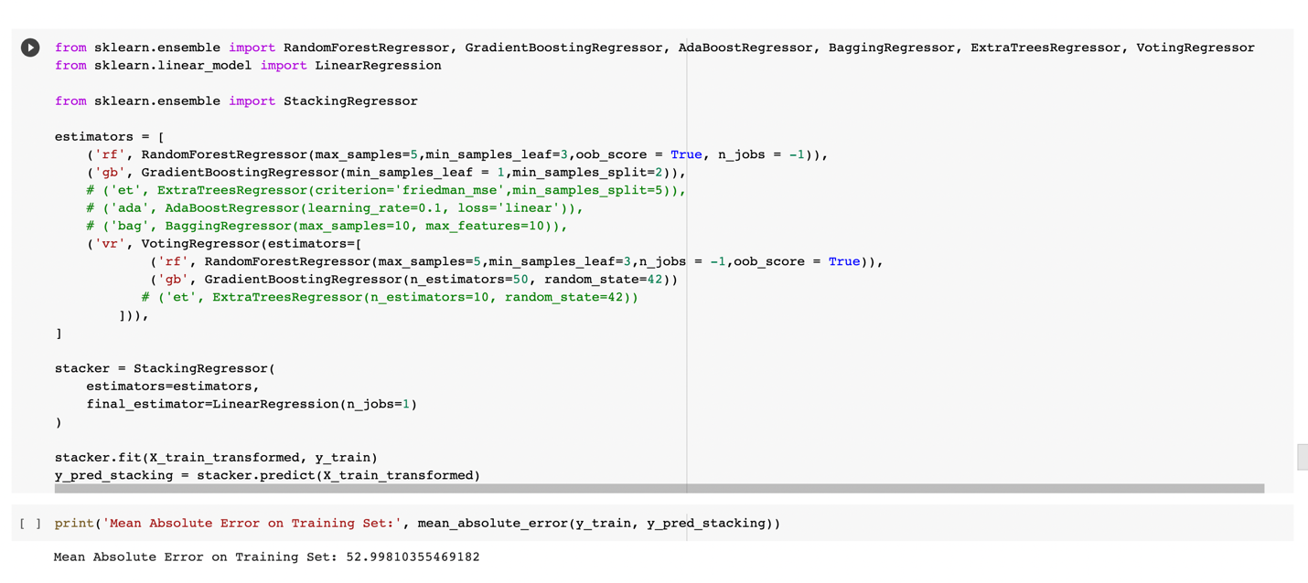
Stacking Regressor

Slide 23
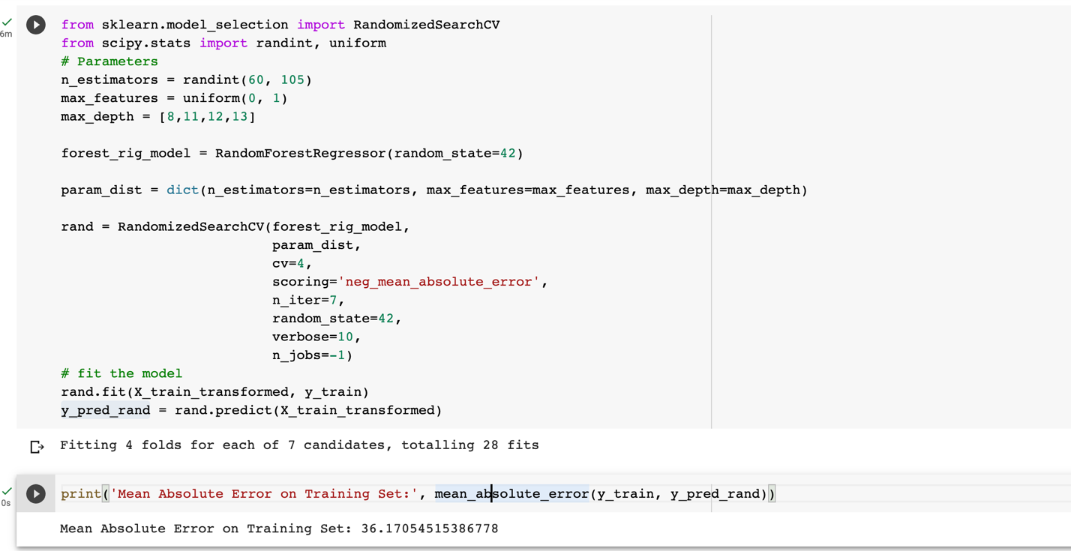
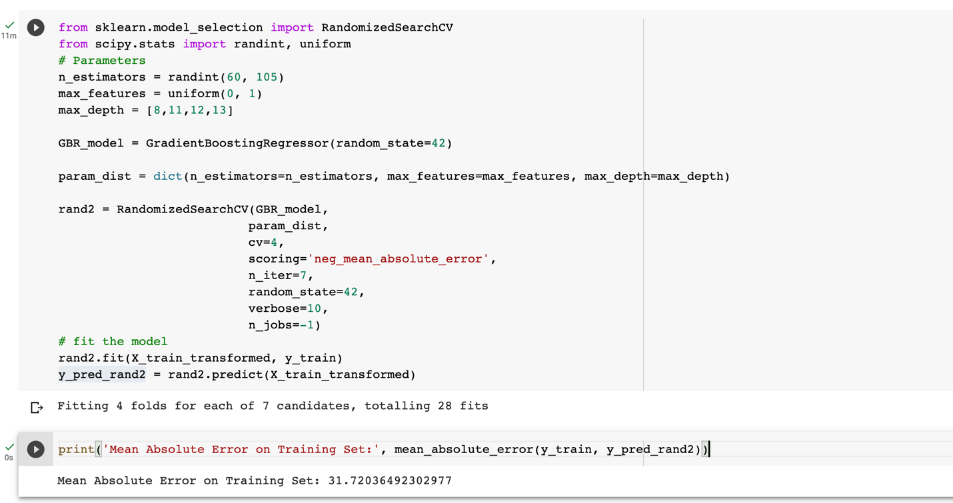
Hyper Parameter Tuned
Random Forest
Gradient Boosting

Slide 24
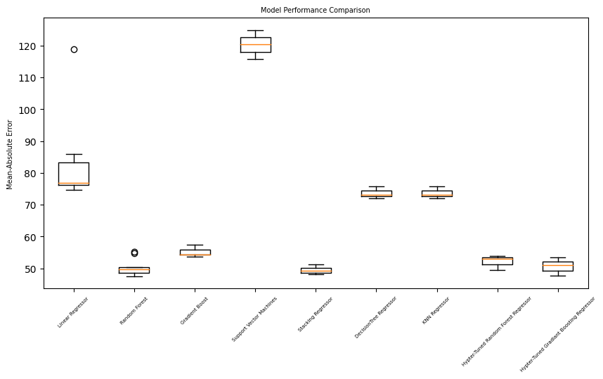
Model Evaluation

Slide 25
Comparison
Models | MAE
Linear Regression | 53
SVM | 45
Decision Tree | 66
KNN | 73
Neural Net | 72
Random Forest | 50
Gradient Boosting | 53
Stacking Regressor | 52
Hyperparameter Tuned Random Forest | 35
Hyperparameter Tuned Gradient Boosting | 31
Best Model:
Hyperparameter Tuned Random Forest
Gradient Boosting

Slide 26
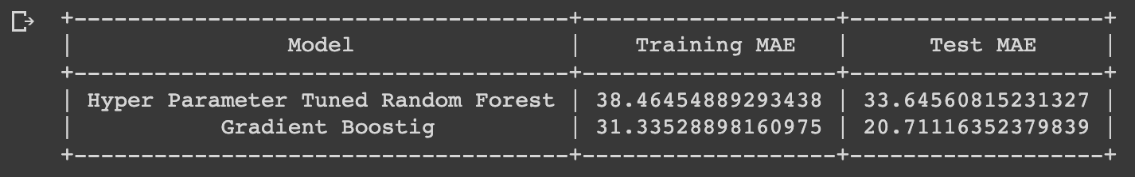
Comparison
Overfitting?
Hyper Parameter Tunes Random Forest appears to perform well on test set as well.
Gradient Boost might be overfitting on new and unseen data.

Slide 27
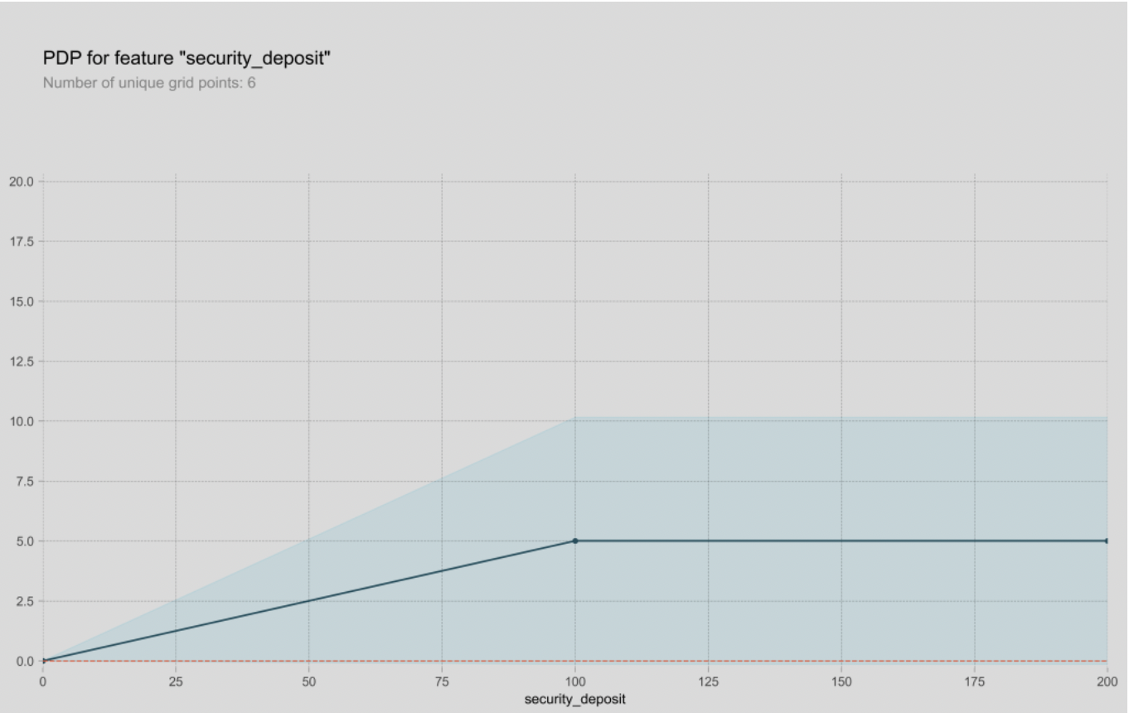
Prediction
This PDP graph shows how a certain feature affect Airbnb rates

Slide 28
Conclusion
There is always room for improvement.
Exploring additional feature engineering techniques.
More ensemble models.
Better hyperparameter optimization.
Deep learning

Slide 29
Thank you

